Slide 1
LATENT OCEAN
Data that organizes itself.
Diren Kumaratilleke · direnavk@outlook.com
www.latentocean.com

Slide 2
THE PROBLEM
Today's data systems chase what's common and miss what matters. The most valuable patterns hide in the rare events, the unusual signals, the connections nobody is looking for.
LATENT OCEAN
2 / 15

Slide 3
WHY NOW
Data is multiplying faster than anyone can understand it.
The next generation of systems has to organize itself.
INGESTION
FOLLOW THE FLOW
REORGANIZE ITSELF
Read any kind of data which can be structured or messy, big or small.
Don't just see what's there and be capable of tracking how data patterns move.
Build its own structure as it learns. No engineer required.
LATENT OCEAN
3 / 15

Slide 4
WHAT IT IS
A new way to read data;
one that lets every kind of information speak the same language.
Lets every kind of data line up against every other.
LESS NOISE
REUSABLE PARTS
ONE SHARED LANGUAGE
LATENT OCEAN
4 / 15

Slide 5
HOW IT WORKS
Two things, attached to every row.
48
4
BITS
NUMBERS
A FINGERPRINT
AN UNUSUALNESS SCORE
A barcode for every row of data. Two rows that are similar get similar barcodes. Two rows that are different get very different ones. This is how the system knows what belongs together, across millions of rows.
Four numbers per row. How predictable it is, how rare its position is, how anomalous it looks, and how all of that combines into one signal. The score tells you whether a row is ordinary, or worth a closer look.
LATENT OCEAN
5 / 15

Slide 6
BEFORE & AFTER
What rows looked like. What rows look like now.
BEFORE · JUST ROWS
AFTER · STRUCTURALLY AWARE
ID | DATE | AMOUNT
A-1024 | Mar 12 | $340,000
A-1025 | Mar 14 | $415,000
A-1026 | Mar 18 | $398,000
A-1027 | Mar 21 | $372,000
A-1028 | Mar 25 | $450,000
ID | FINGERPRINT | SCORE
A-1024 | 11010110… | 0.21
A-1025 | 11010101… | 0.18
A-1026 | 11011010… | 0.24
A-1027 | 00101110… | 0.91
A-1028 | 11010111… | 0.22
Same as every other row. Nothing tells you which one matters.
A-1027 surfaces immediately. Its fingerprint is unlike its neighbors and its score is high.
LATENT OCEAN
6 / 15

Slide 7
USE CASE · SEC FILINGS
Five thousand filers in.
One stood out.
TOP-1 OUT OF 4,999 PUBLIC FILERS
American Electric Power
Asset Retirement Obligation
INDEPENDENTLY VERIFIED · THREE SOURCES
DELOITTE
EY
AEP 10-K
On the Radar · Jul 2025
2025 SEC Comment Letter Trends
Annual Report · FY 2023
Asset retirement obligations require “significant management estimates” and rank among the highest-scrutiny disclosures.
AROs remain a recurring topic in SEC staff reviews of utility 10-Ks.
Cook nuclear decommissioning ARO of $2.4B, plus material coal-ash retirement liabilities.
LATENT OCEAN
7 / 15

Slide 8
WHAT MAKES IT DIFFERENT
Most data systems are designed by hand. Latent Ocean grows on its own with no setup needed.
TODAY'S DATA
LATENT OCEAN
Designed once
Architecture frozen
Domain-specific
Brittle to new data
Discovers its own structure
Reorganizes itself
Works across domains
Grows with new data
LATENT OCEAN
8 / 15

Slide 9
WHERE IT APPLIES
One system. Many worlds.
F
M
R
FINANCE
MEDICINE
RESEARCH
Reading the SEC archive as one connected story and surfacing the companies that don't fit.
Finding the connections across millions of medical papers that no practitioner has time to read.
Connecting centuries of scientific thinking. Finding the threads no one person could see in a lifetime of reading.
AND TOOLS BUILT ON TOP · FOR EVERY OTHER FIELD
LATENT OCEAN
9 / 15

Slide 10
WHAT IT'S ALREADY DONE
Real findings. Real domains.
Found rare, high-value patterns in messy real-world data. Patterns that line up with what experts already know, and reveal what they don't.
1
Reads live data and surfaces what matters most. Adjustable by region and timeframe.
2
Applied a single system to multiple entirely different fields, without retraining.
3
LATENT OCEAN
10 / 15

Slide 11
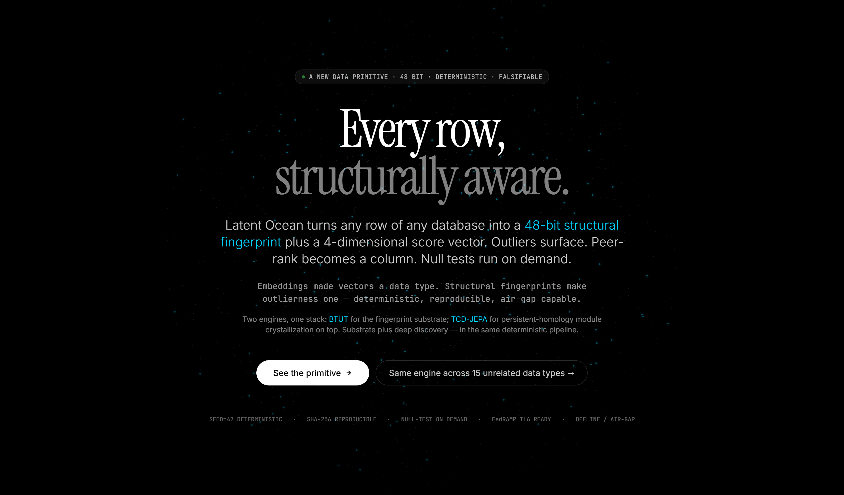
SEE IT WORK · LANDING
Every row, structurally aware.
The home page. What visitors see first.
LATENT OCEAN
11 / 15

Slide 12
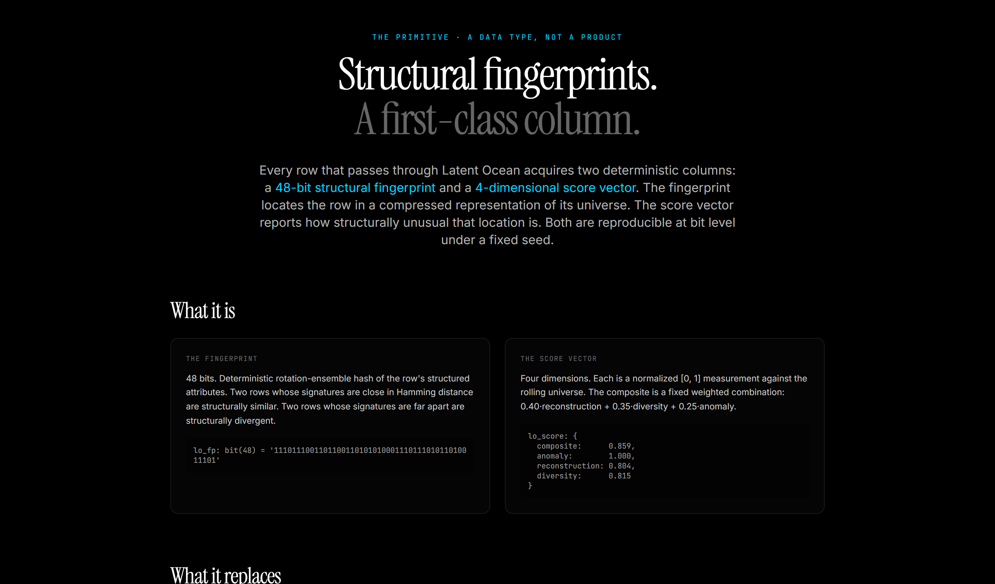
SEE IT WORK · PLATFORM
Structural fingerprints. A first-class column.
The product, explained. One primitive, fifteen data shapes.
LATENT OCEAN
12 / 15

Slide 13
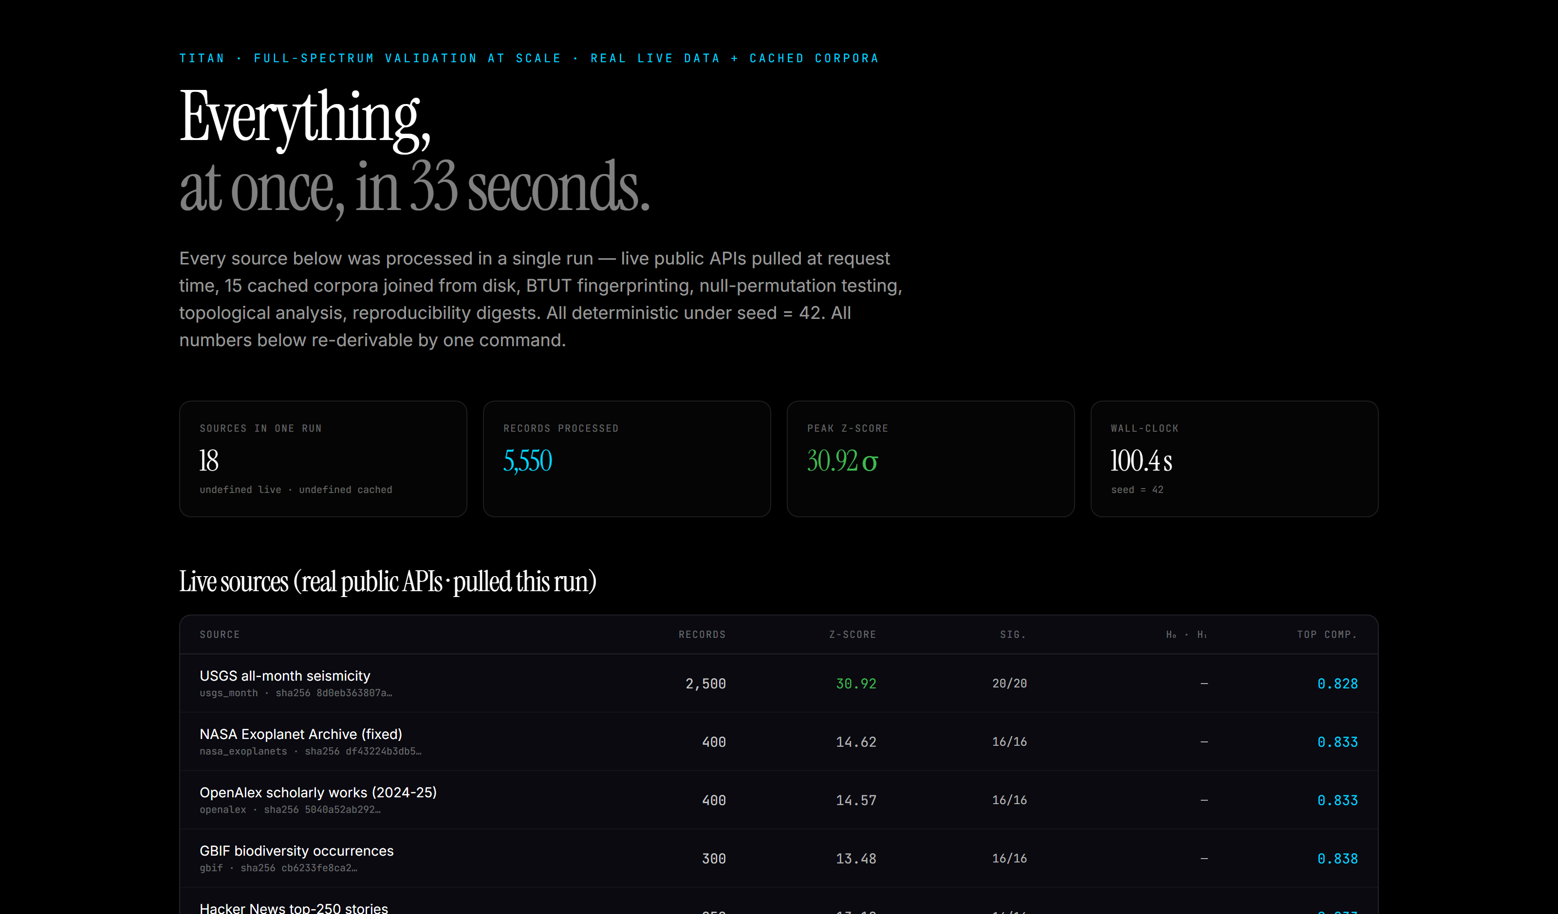
SEE IT WORK · TITAN
Everything, at once, in 33 seconds.
Eighteen public APIs, processed live, in a single deterministic run.
LATENT OCEAN
13 / 15

Slide 14
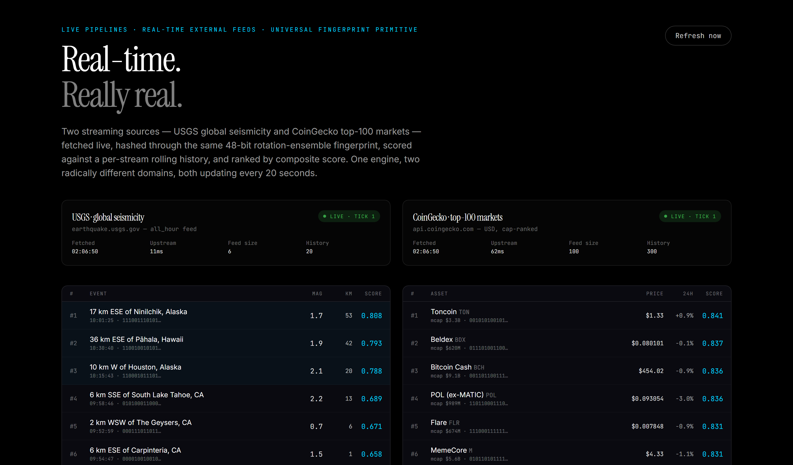
SEE IT WORK · LIVE
Real-time. Really real.
Two streaming sources, scored every twenty seconds.
LATENT OCEAN
14 / 15

Slide 15
DEFENSIBILITY
Trade secrets, with timestamps no one can fake.
✓
The deep technical methods are intended to be protected as trade secrets.
Every invention is cryptographically time-stamped on a public blockchain.
Anyone can verify the creation timestamp without ever seeing the invention itself.
LATENT OCEAN
15 / 15

